Slide 1




AI for Autism - Enhancing Emotional Understanding through Text Emotion Classification
DATA WIZARDS

Slide 2

PROBLEM FACED:
AUTISTIC INDIVIDUALS OFTEN STRUGGLE WITH RECOGNIZING NONVERBAL CUES LIKE FACIAL EXPRESSIONS AND TONE, MAKING IT HARDER TO FORM AND MAINTAIN RELATIONSHIPS, LEADING TO SOCIAL MISUNDERSTANDINGS AND ISOLATION.
SOLUTION:
DEPLOY AI-POWERED TEXT EMOTION CLASSIFICATION USING INTEL ONEAPI IN WRITTEN COMMUNICATION IN ORDER TO ENHANCE EMOTIONAL UNDERSTANDING BY PEOPLE WITH ASD.
THE INTERPRETATION OF EMOTIONAL MEANING AND SOCIAL COMMUNICATION IN ASD SHOULD BE ENHANCED WITH ADVANCED AI-DRIVEN TEC.

Slide 3

AI - Autism Detection
Data Preprocessing
Feature Extraction
Data Collection
Embedding Layer
Classification
Video
Data Cleaning
Text Representation
Contextual Embedding
Model Training
Audio
Normalisation
Dimensionality Reduction
Vector Generation
Emotion Prediction
Cloud Speech to Text
Tokenization
Intel oneAPI Integration
Feature Selection
Data Visualization
Text
Stop-word Removal
Batch Processing
Output Feature Vectors
Speed up Factor

Slide 4


Intel OneAPI
Intel oneAPI serves as a powerful tool in our autism detection project, providing a unified programming model that allows us to leverage the capabilities of various hardware platforms.
This enables us to optimize our machine learning algorithms and achieve efficient data processing for better outcomes in understanding emotional expressions in individuals with Autism Spectrum Disorder (ASD).
Key Features
Unified Development Environment
Performance Optimization
Data Parallel C++
Machine Learning Libraries
Real-time Feedback Systems

Slide 5

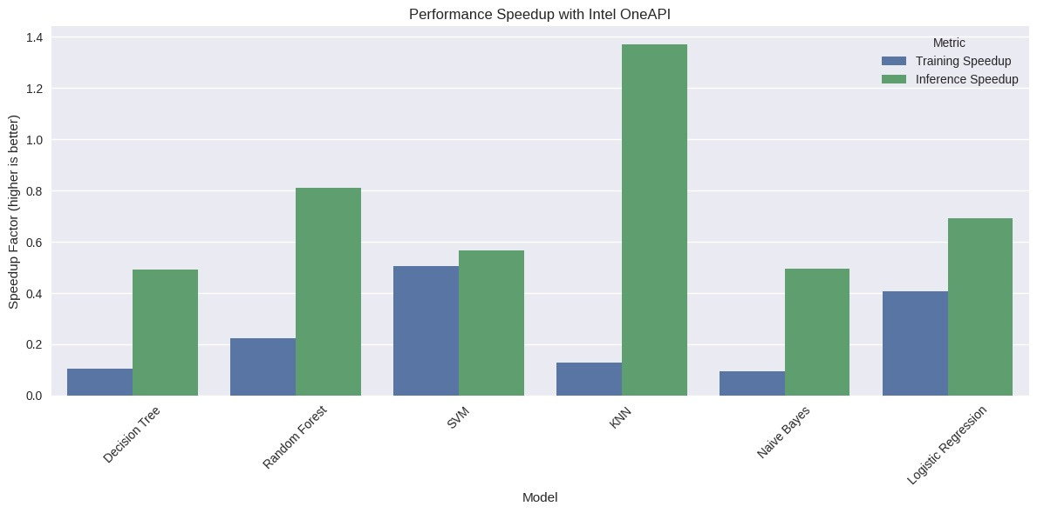
Speed up factor
Without Intel OneAPI
1.0087 SECONDS
With Intel OneAPI
0.5824 SECONDS

Slide 6

Use Cases
Limitations
Enhanced Communication Support
Data Dependence
Real-time Emotion Feedback in Chat Applications
Real-time Processing Challenges
Educational Tools for Emotional Learning
Emotional Complexity
Therapeutic Support for ASD
Ethical and Privacy Concerns
Child Care Monitoring
User Adaptation and Learning Curve

Slide 7


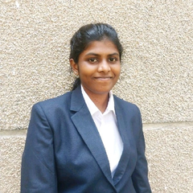
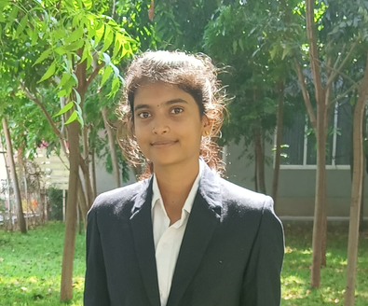
Saran Kumar
Team Leader
Murugan
DATA
WIZARDS
Team Member
Vidhya
Team Member
Sathya
Team Member

Slide 8
Thank You

